Slide 1
Tantech Holdings
NASDAQ：TANH

Slide 2
1
Company Overview
TANH
2
Brands & Products
Table of Contents
Certifications & Honors
3

Slide 3
Company Overview

Slide 4
COMPANY OVERVIEW
Tantech Holdings
Established in October 2002, Tantech is a leading high-tech enterprise, specializing in the R&D, manufacturing, and sale of bamboo charcoal products for use as air purification products, deodorizers, and bamboo vinegar.
In 2017, the company acquired a controlling equity interest in Suzhou
E-Motors and expanded into electric vehicles.
In November 2020, Tantech established two additional subsidiaries to produce and market electric vehicles.
In 2022, Tantech established North American subsidiaries, EPakia Inc. & EPakia Canada, to develop its biodegradable packaging business.

Slide 5
DEVELOPMENT HISTORY
Business focus will be strategically transformed and upgraded in the future, with global energy-saving and environmentally friendly, biodegradable paper and pulp model products and solutions as the main operation direction.
Establishment
2002.10
Started business
2022.5-2022.7
Setup
EPakia Inc. &
EPakia Canada
Strategic transformation and upgrade
2010.11
Tantech Holdings
2015.3.24
Listed on NASDAQ
2017-2020
Expanded into electrical vehicle industry
十八年史历程

Slide 6
Brands & Products

Slide 7
BRANDS
Brands

Slide 8
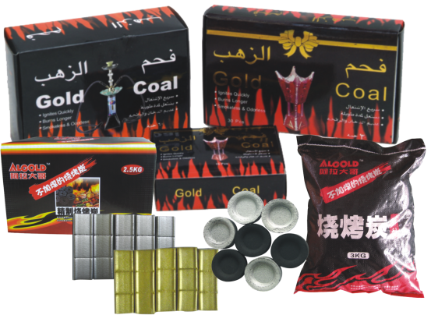
CHARCOAL PRODUCTS
Zhejiang Tantech Bamboo Technology Co, Ltd
Tantech Holdings charcoal products manufacture facility has an area of 40,000 sqm, and is located in the National Economic and Technological Development Zone of Lishui City, Zhejiang Province.
Its main products include four series of charcoal product lines: cleaning household, purifying and deodorizing, outdoor barbecue and plant nutrition, with more than 100 types of product such as kitchen and bathroom cleaners, bamboo charcoal, activated charcoal, barbecue charcoal, hookah charcoal, bamboo vinegar liquid and plant growth agent, etc.
Products are sold through mainstream domestic supermarkets and exported to Europe, America, Japan, Korea, and the Middle East.

Slide 9
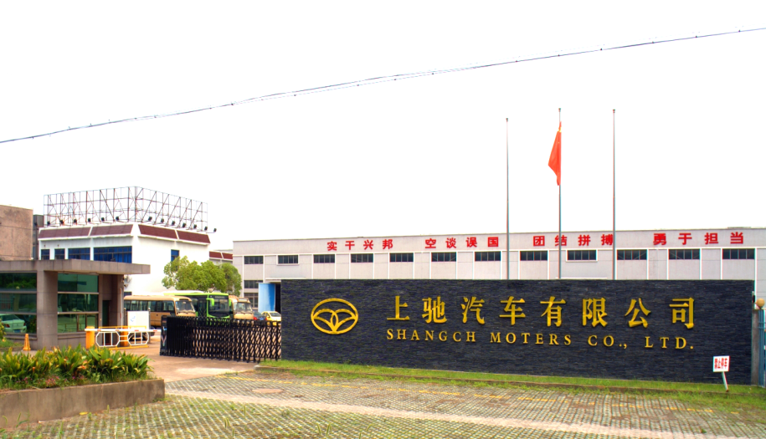
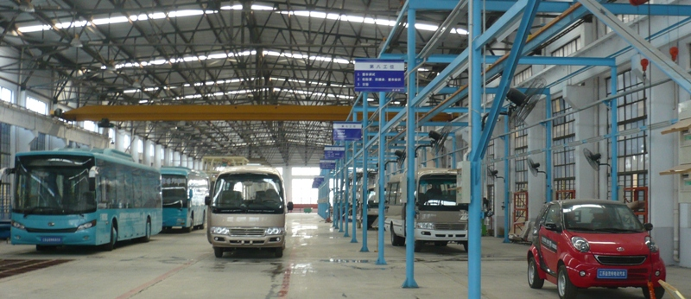
NEW ENERGY VEHICLE
Zhejiang Shangchi New Energy Automobile Co., Ltd
Founded in 2011, Shangchi Auto's manufacturing base is located in Zhangjiagang City, Jiangsu Province.
It specializes in the manufacturing of new energy electric vehicles, and has complete welding, assembly, chassis modification, painting, and testing product lines; Shangchi Auto is a national high-tech enterprise.
The strategic goal of Shangchi Auto is to build a leading enterprise of light weight new energy vehicles in China.

Slide 10
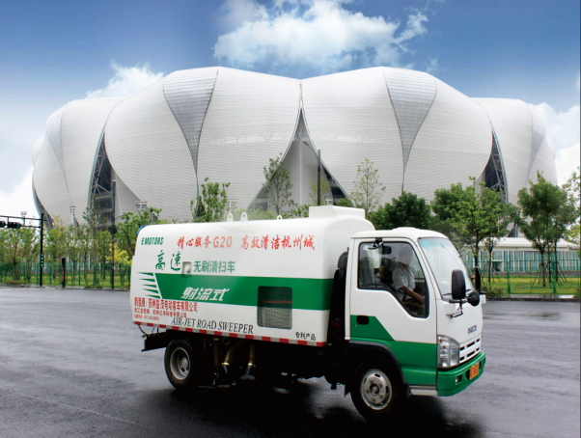
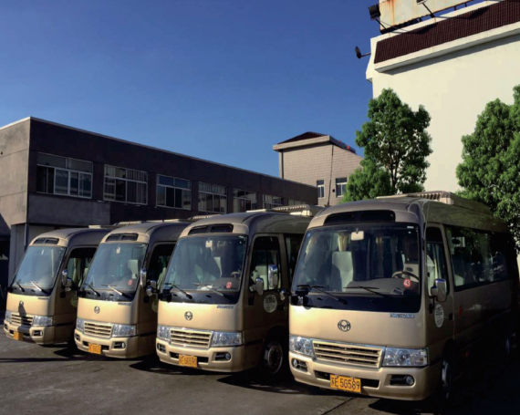
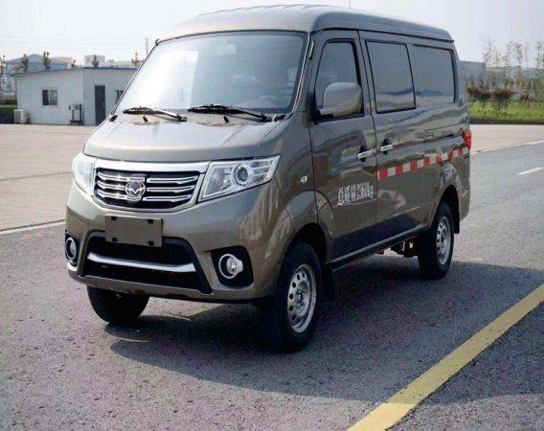
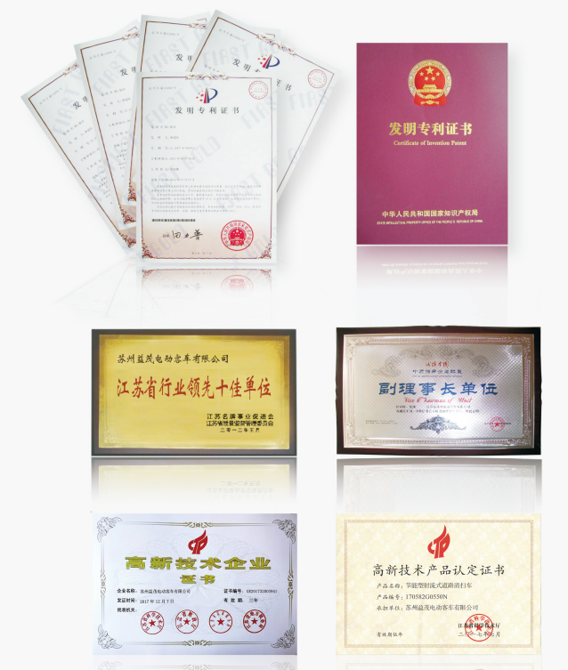
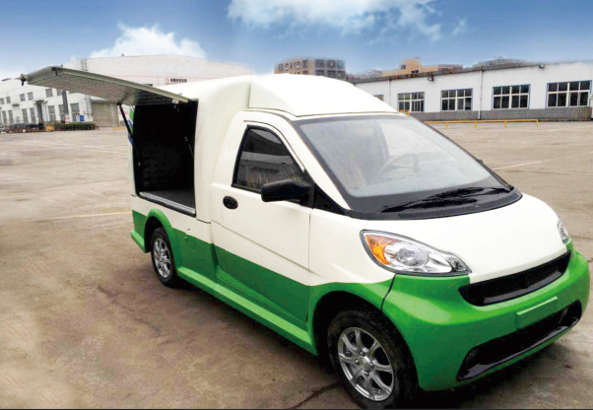
NEW ENERGY VEHICLE
Shangchi Auto's main products include electric logistics vehicles and Tornado contactless high-speed garbage sweepers, which are the designated vehicles for the G20 Hangzhou Summit in 2016. There are more than 10 models of electric buses and garbage sweepers.

Slide 11
MODELED FIBER PRODUCTS
EPakia Inc. was founded in May 2022 and headquartered in Washington, DC.
The subsidiary is committed to creating sustainable and fully degradable packaging products and focuses on environmental protection.
Through the combination of online and offline sales, EPakia Inc. strives to realize the R&D, promotion, and sales of biodegradable paper-plastic products in the US market.
EPakia Inc. promotes the application of bamboo-based degradable paper-plastic products in the food industry by leveraging parent company’s rich industry experience, technology accumulation, and global marketing network in the field of low-carbon environmental protection.

Slide 12
MODELED FIBER PRODUCTS
EPakia Inc.
Company current product line includes plates, bowls, trays and packaging boxes, etc.
Plates
Bowls
Trays
Packaging Boxes

Slide 13
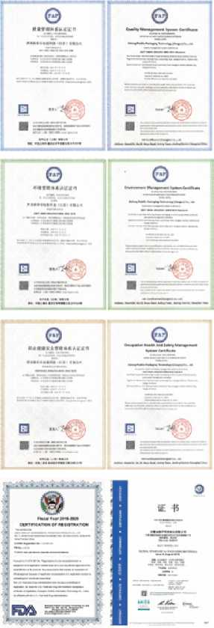
MODELED FIBER PRODUCTS

Slide 14
Certifications & Honors

Slide 15
INDUSTRY STASTUS
Tantech is China's leading bamboo charcoal product company
Tantech is the leading company of bamboo-based degradable products
Industry Leader

Slide 16
TECHNICAL ADVANTAGE
Tantech owns 137 registered trademarks and numerous patents

Slide 17
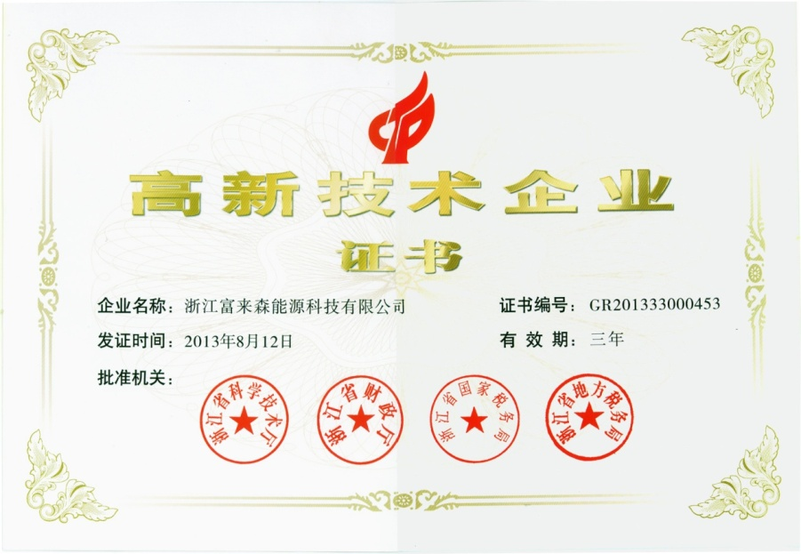
CERTIFICATION AND HONOR
Tantech is a national high-tech company

Slide 18
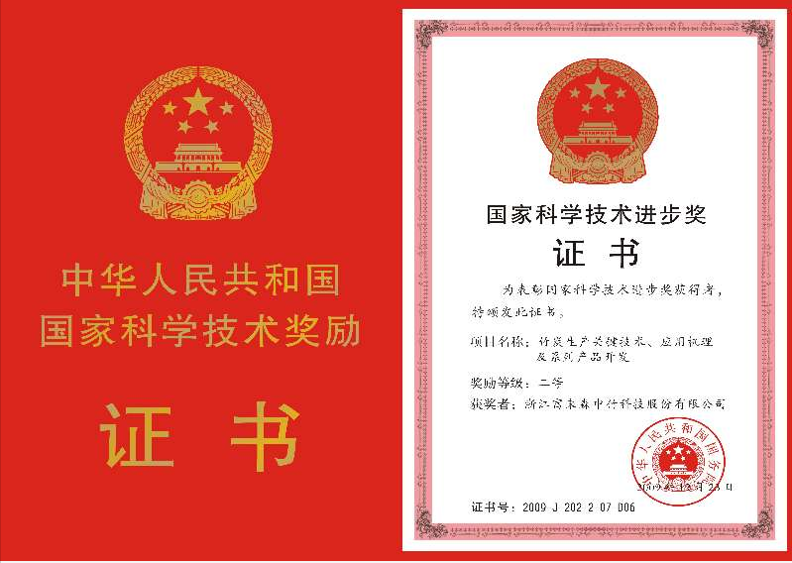
CERTIFICATION AND HONOR
Tantech won the National Prize for Progress in Science and Technology

Slide 19
THANK YOU

